Slide 1
How to work with SVN
svn

Slide 2
Repository Creation
Source: https://tortoisesvn.net/docs/nightly/TortoiseSVN_en/tsvn-repository.html

Slide 3
Creating The Repository With TortoiseSVN
Open the windows explorer
Create a new folder and name it e.g. SVNRepository
Right click on the newly created folder and select TortoiseSVN → Create Repository here....
Select automatic folder structure creation

Slide 4
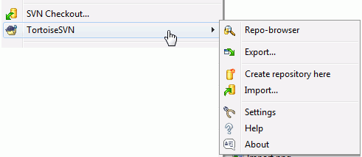

Slide 5
Note
A repository is then created inside the new folder. Don't edit those files yourself!!!. If you get any errors make sure that the folder is empty and not write protected.
You will also be asked whether you want to create a directory structure within the repository. Find out about layout options in the section called “Repository Layout”.

Slide 6
Local Access to the Repository
To access your local repository you need the path to that folder. Just remember that Subversion expects all repository paths in the form file:///C:/SVNRepository/. Note the use of forward slashes throughout.
To access a repository located on a network share you can either use drive mapping, or you can use the UNC path. For UNC paths, the form is file://ServerName/path/to/repos/. Note that there are only 2 leading slashes here.
Prior to SVN 1.2, UNC paths had to be given in the more obscure form file:///\ServerName/path/to/repos. This form is still supported, but not recommended.

Slide 7
Repository Layout
There are some standard, recommended ways to organize a repository. Most people create a trunk directory to hold the “main line” of development, a branches directory to contain branch copies, and a tags directory to contain tag copies. If a repository holds only one project, then often people create these top-level directories:
/trunk
/branches
/tags

Slide 8
Because this layout is so commonly used, when you create a new repository using TortoiseSVN, it will also offer to create the directory structure for you.
If a repository contains multiple projects, people often index their layout by branch:
/trunk/paint
/trunk/calc
/branches/paint
/branches/calc
/tags/paint
/tags/calc
...or by project:
/paint/trunk
/paint/branches
/paint/tags
/calc/trunk
/calc/branches
/calc/tags

Slide 9
Install subversive plugin in Eclipse
The Subversive installation consists of installing the
i) Subversive plug-in and
Ii)) Subversive SVN Connectors.
Source: https://eclipse.org/subversive/installation-instructions.php

Slide 10
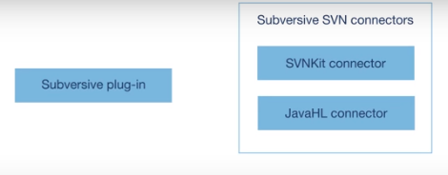

Slide 11
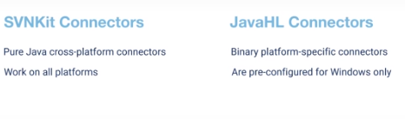
To work with repository, subversion connectors should be installed
Any one connector can be used

Slide 12
Phase 1 - Installation of the Subversive Plug-In

Slide 13
Option 1 - Use an Eclipse Simultaneous Release Update Site
This method is recommended if you wish to install a stable Subversive version that is an integral part of the yearly Eclipse Simultaneous Release. It allows you to install the Subversive plug-in using an Eclipse update site for an Eclipse Simultaneous Release.
Run Eclipse and select Help > Install New Software... from the main menu.
On the dialog that appears, select a pre-configured simultaneous release update site in the Work with combo-box. For example, for the Juno release, select the "Juno - http://download.eclipse.org/releases/juno" update site.
Wait a few seconds until the content of the selected update site is displayed under the combo-box.
Expand the Collaboration group and select the Subversive features that you would like to install. Certain Subversive features are required if you want to work with SVN, others are optional and offer some additional functionality. You can skip the optional features, if you wish.
Follow the next steps to install the selected Subversive features using the standard plug-in installation procedure. Reboot Eclipse after installation is complete.
Follow the instructions below to install Subversive connectors.

Slide 14
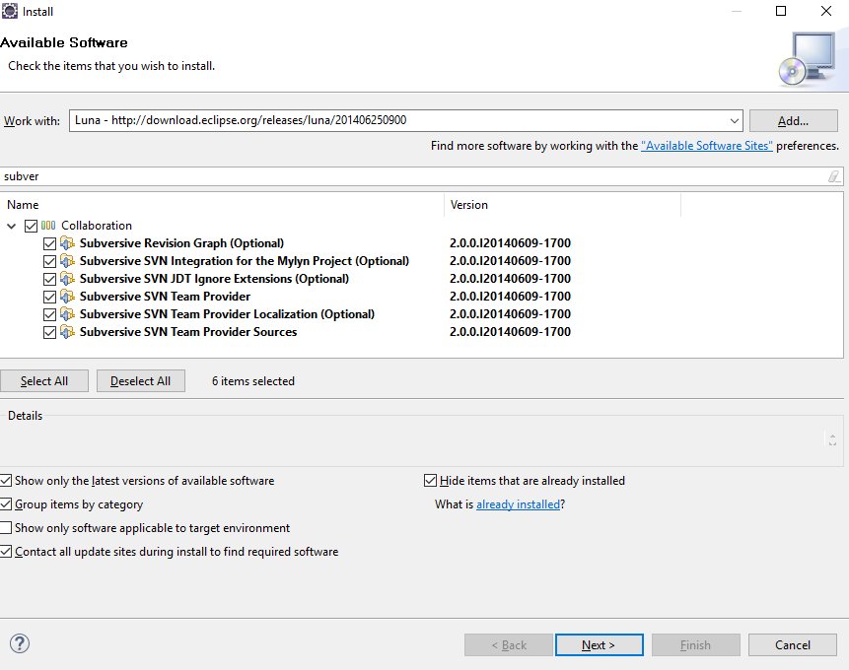

Slide 15
Main thing
SVN Team provider is the main thing

Slide 16
Option 2 - Use a Subversive Update Site
You can install Subversive using its online or archived update site. Use this method to install the Early Access Build that isn't available in the Eclipse Simultaneous Releases.
Run Eclipse and select Help > Install New Software... from the main menu.
In the Install dialog that appears, press the Add... button and specify the path to an online or archived Subversive update site. You can find information about the available Subversive update sites on the Downloads page.
Select the required Subversive features to install and follow the standard plug-in installation procedure. Reboot Eclipse after installation is complete.
Follow the instructions below to install Subversive connectors.

Slide 17
Option 3 - Use Eclipse Marketplace Client
If you have Eclipse Marketplace Client installed, you can use it to install the latest stable release of Subversive.
Open Eclipse Marketplace Client and search for the Subversive project.
Click on the Install button next to the Subversive listing.
Select required Subversive features to install and follow the standard plug-in installation procedure. Reboot Eclipse after installation is complete.
Follow the instructions below to install Subversive connectors.

Slide 18
Steps to do
Once the svn plugin software is installed.
Eclipse will prompt for the restart
Click on restart
Close the work bench

Slide 19
Phase 2 - Installation of Subversive SVN Connectors
Click on Window -> Show view → svn repositories
Click any one of two connectors
1. svn kit connector
2. javahl connectior
Click on finish

Slide 20
Install Svn connector
Go to show view – select svn perspective
One svn connector popup will be appeared
Select svn connectors to install (svn connector or java hl )
Click on next – next until finish (follow the instructions)
Restart the eclipse
See below screenshot

Slide 21
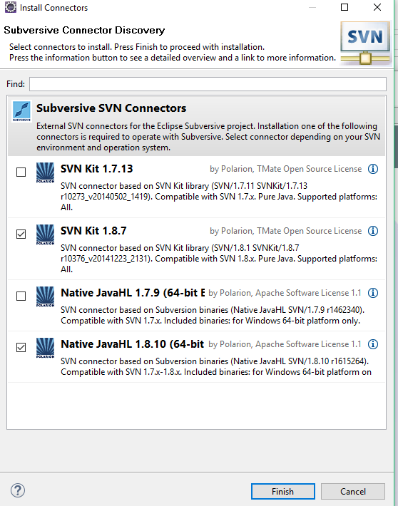

Slide 22
Subversive SVN Connectors does not appear in eclipse
Delete the .metadata folder from the workspace
Restart the server.

